Slide 1

IoT based Automated Street Lighting System
Experiment 1:
Navarro, Rod Geryk C.
CPE162P- 4 - E01

Slide 2
OBJECTIVES
1. To demonstrate how an IoT-based Automated Street Lighting System works. - This project aims to show how a street lighting system can automatically turn lights ON or OFF based on environmental conditions such as light intensity or motion detection, using Internet of Things technology.
2. To apply knowledge gained from Logic Circuits and Switching Theory, Microprocessors, CPE160P, and CPE161P. - It applies logic gates and switching methods from logic circuits, microprocessor programming techniques, and practical skills from the embedded systems courses to create a functioning smart lighting system.
3. To apply embedded systems and IoT using the Arduino development kit. - Students will learn how to build and program an embedded system using the Arduino platform.
4. To use ThingSpeak for data collection and analysis. - Students will connect their IoT-based system to the internet and upload data to ThingSpeak, a cloud-based IoT platform.

Slide 3
MATERIALS
Arduino Kit
Laptop
ESP32 Dev Module - x1
LEDs - x5
220 ohm Resistors - x5
Photoresistor - x1

Slide 4
INTRODUCTION
This project shows how a smart street lighting system works using an IoT device called the ESP32 Dev Module. It uses sensors to control lights automatically and sends data to ThingSpeak for analysis. The project apply lessons from logic circuits, microprocessors, and embedded systems.

Slide 5
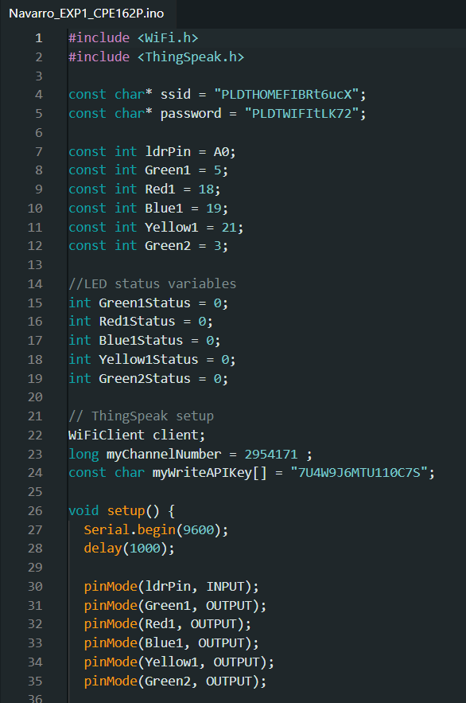
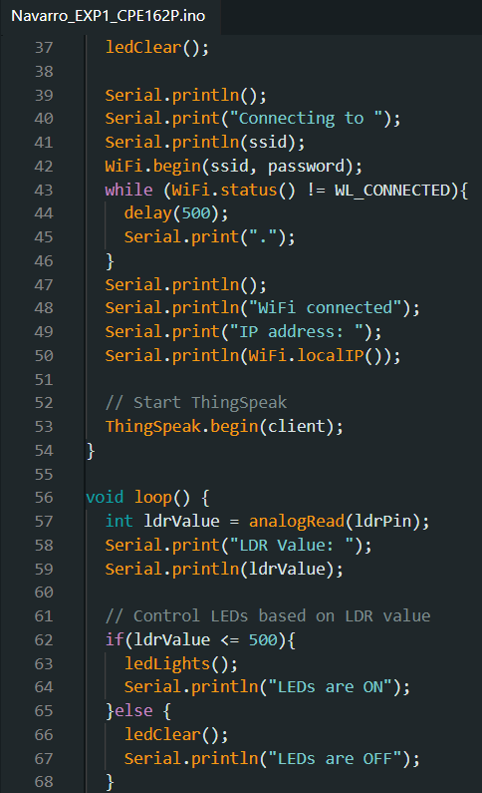
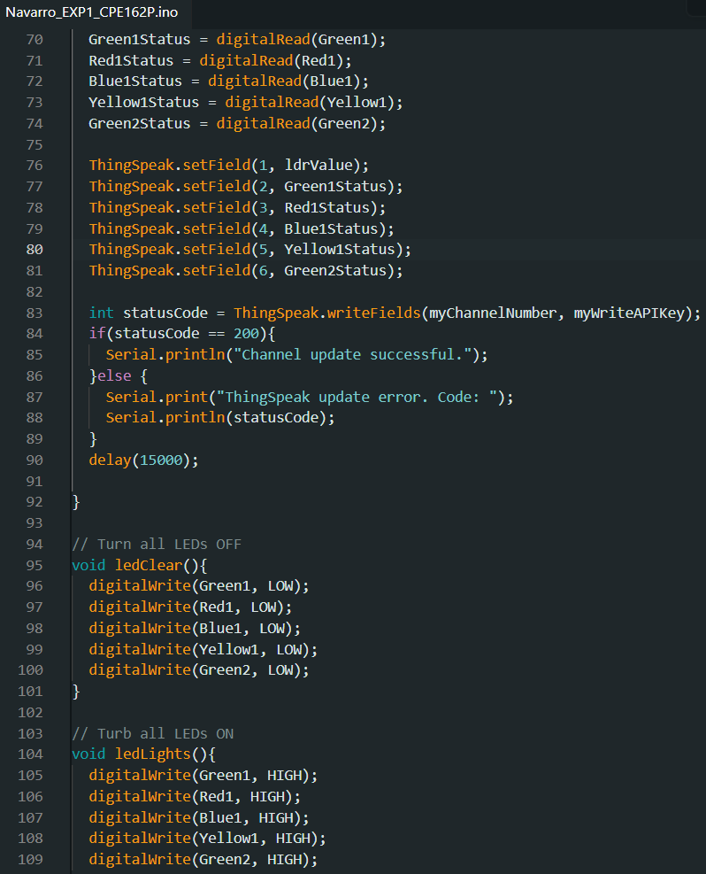
SOFTWARE DISCUSSION

Slide 6
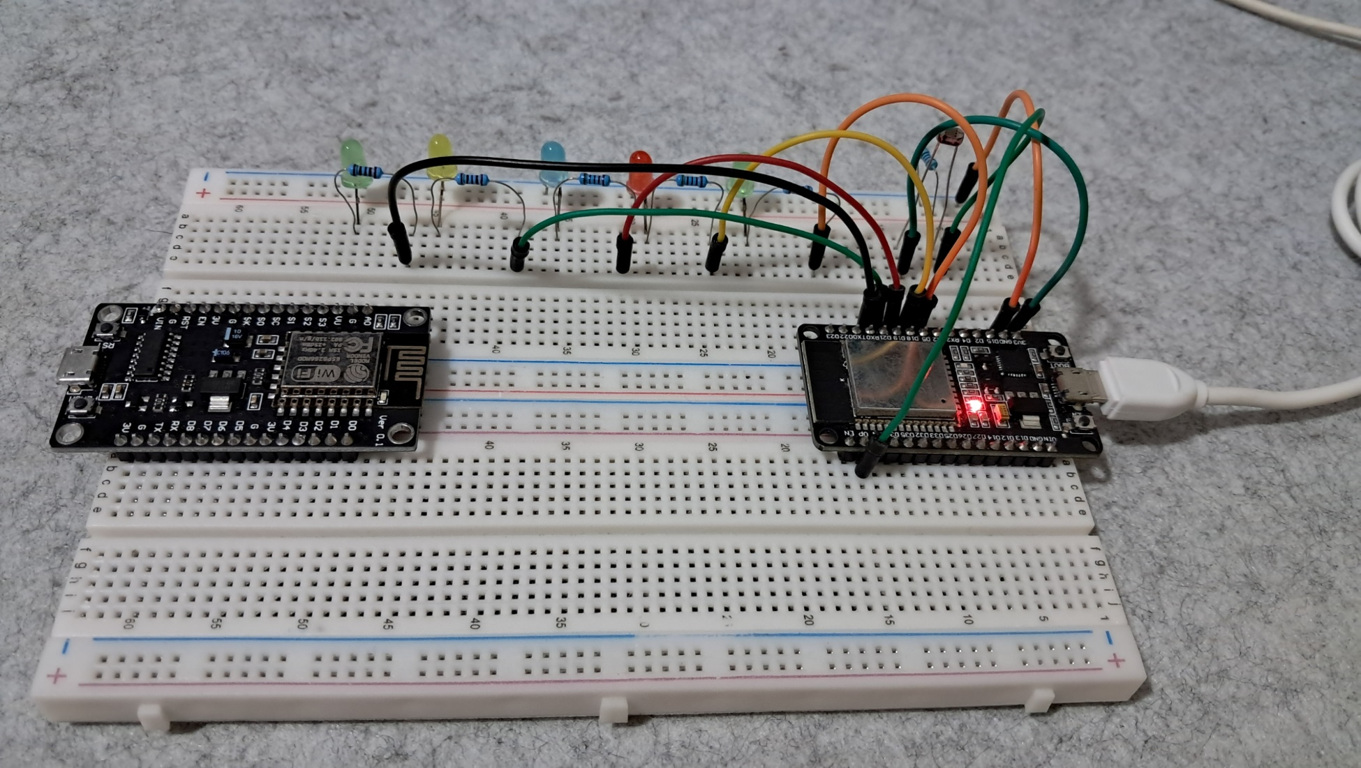
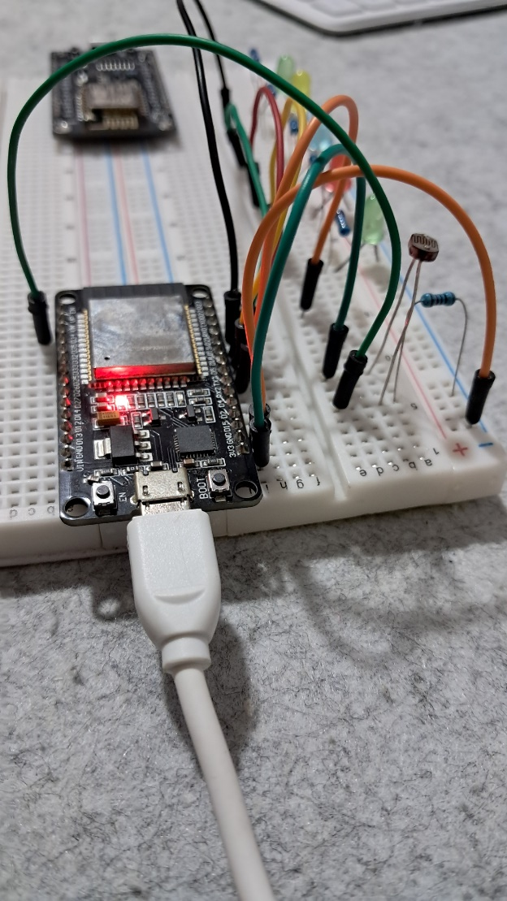
HARDWARE DISCUSSION

Slide 7
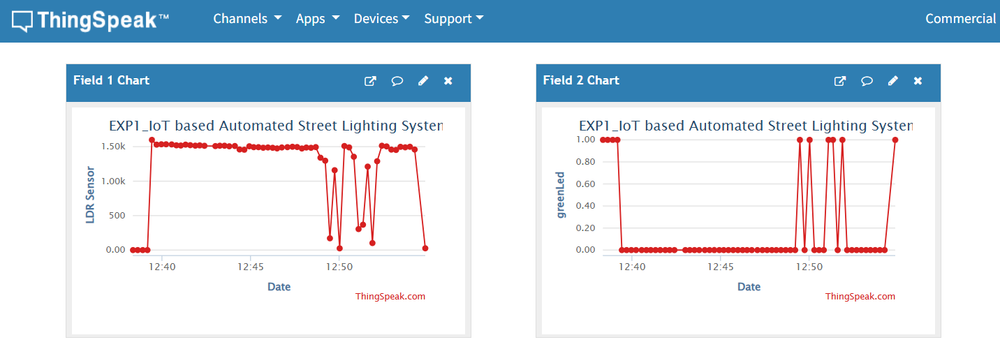
SAMPLE OUTPUT

Slide 8
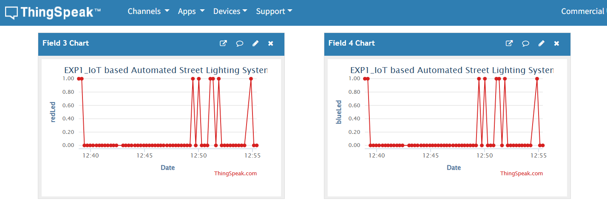
SAMPLE OUTPUT

Slide 9
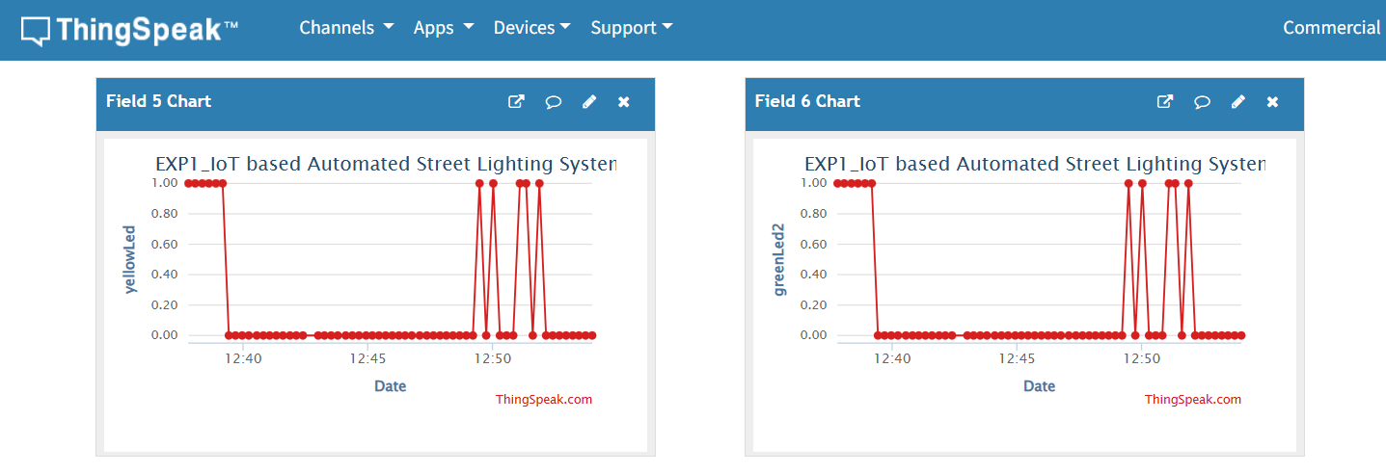
SAMPLE OUTPUT

Slide 10
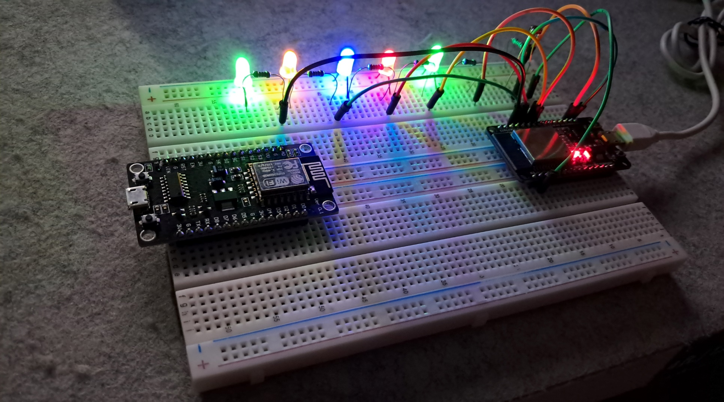
SAMPLE OUTPUT

Slide 11
DEMO VIDEO
Please click the link below of the EXP1_DemoVideo_CPE162P:
https://youtu.be/_IA0jeTSr3w?si=v9sABGkV_e_KxHqa

Slide 12
THANK YOU!

